Slide 1
Spring Framework
Trainer
Uday

Slide 2
Introduction
The Spring framework is a powerful and flexible framework focused on building Java applications.
Framework takes care of most of the low-level aspects of building an application to allow you to actually focus on features and the business logic.
Introduced in 2003
Framework continuously gets updated and streamlined, which makes it quite up to date and aligned with the Java ecosystem right now.

Slide 3
Introduction (Cont..)
This framework mainly focuses on providing various ways to help you manage your business objects.
Spring is an open source
The Spring Framework is divided into modules. Applications can choose which modules they need

Slide 4
Why Spring Framework?
Creating software can be Hard
Spring Framework makes it easy to create java enterprise applications
Flexible, modular, and backwards compatible
Large and active community
Continually innovates and evolves
Open source
Developed by Pivotal

Slide 5
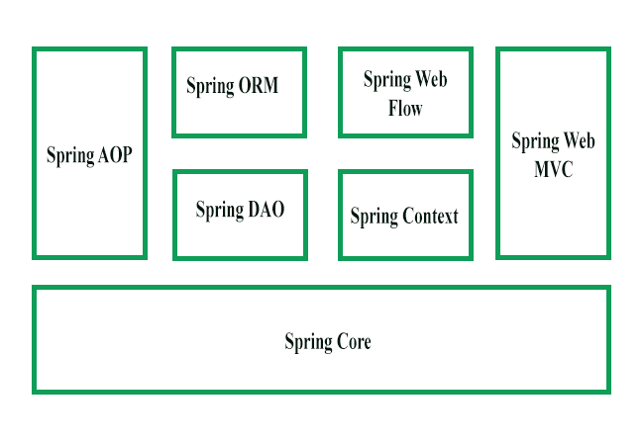
Architecture

Slide 6
Core module
The Core module provides the fundamental parts of the framework, including the IoC and Dependency Injection features.
IOC (Inversion of control) is a concept where the flow of application is inverted instead of the programmer controlling the flow of a program, the external sources (framework, services, other components) take control of it

Slide 7
Core module (Cont..)
IOC can be achieved using dependency injection
DI is a process whereby objects define their dependencies (that is, the other objects they work with)
DI is implemented by constructor injection, setter injection or method injection.

Slide 8
IoC Containers
Spring IoC container and is responsible for instantiating, configuring, and assembling the beans.
The org.springframework.beans and org.springframework.context packages are the basis for Spring Framework’s IoC container.
The BeanFactory interface provides an advanced configuration mechanism capable of managing any type of object.
ApplicationContext is the child interface of BeanFactory interface that provide Spring AOP features, i18n etc.

Slide 9
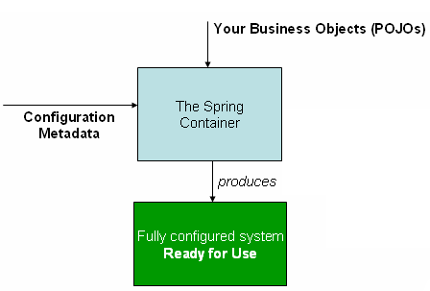
IoC Containers (Cont..)

Slide 10
Spring Bean
Any object in the Spring framework that we initialize through Spring container is called Spring Bean.
Any normal Java POJO class can be a Spring Bean if it’s configured to be initialized via container.

Slide 11
Spring Bean Configuration
Spring Framework provides three ways to configure beans to be used in the application.
XML Based Configuration – By creating Spring Configuration XML file to configure the beans. If you are using Spring MVC framework, the xml based configuration can be loaded automatically by writing some boiler plate code in web.xml file.
Annotation Based Configuration – By using @Service or @Component annotations. Scope details can be provided with @Scope annotation.
Java Based Configuration – Starting from Spring 3.0, we can configure Spring beans using java programs. Some important annotations used for java based configuration are

Slide 12
Spring Bean Scopes
There are five scopes defined for Spring Beans.
singleton – Only one instance of the bean will be created for each container. This is the default scope for the spring beans. While using this scope, make sure bean doesn’t have shared instance variables otherwise it might lead to data inconsistency issues.
prototype – A new instance will be created every time the bean is requested.
request – This is same as prototype scope, however it’s meant to be used for web applications. A new instance of the bean will be created for each HTTP request.
session – A new bean will be created for each HTTP session by the container.
global-session – This is used to create global session beans for Portlet applications.

Slide 13


Slide 14
Dependency Injection in Spring framework
Spring framework provides two ways to inject dependency
By Constructor
By Setter method

Slide 16
Annotation Based Configuration
@Autowired: The @Autowired annotation can apply to bean property setter methods, non-setter methods, constructor and properties.

Slide 18
Spring Bean Life Cycle
Spring bean is responsible for managing the lifecycle of beans created through the spring container.
The bean lifecycle consists of post-initialization and pre-destruction callback methods.
Spring can recognize the initialization and destruction callback methods using @PostConstruct and @PreDestroy annotations over the methods

Slide 20
Reading from Properties files
Spring provides capability to read properties from properties files
Spring provides different annotations like @PropertySource & @Value to read properties
Spring also provides Environment class to read properties

